Slide 1
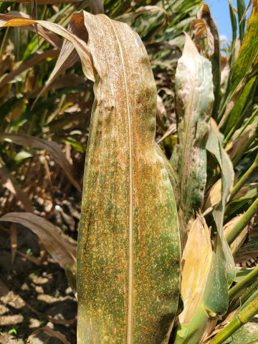
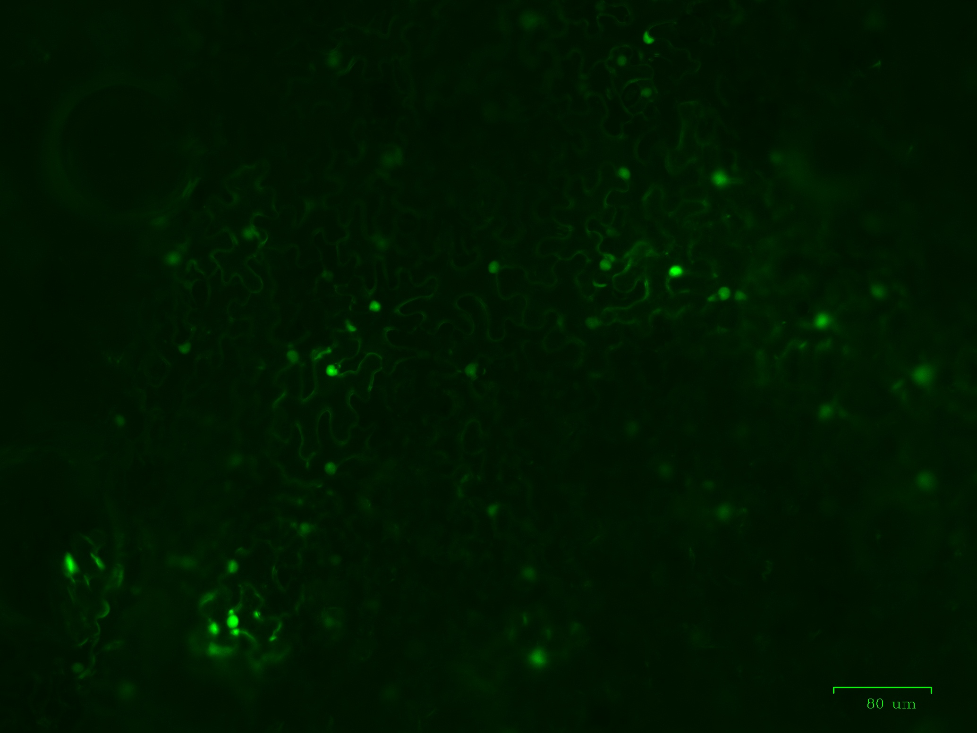
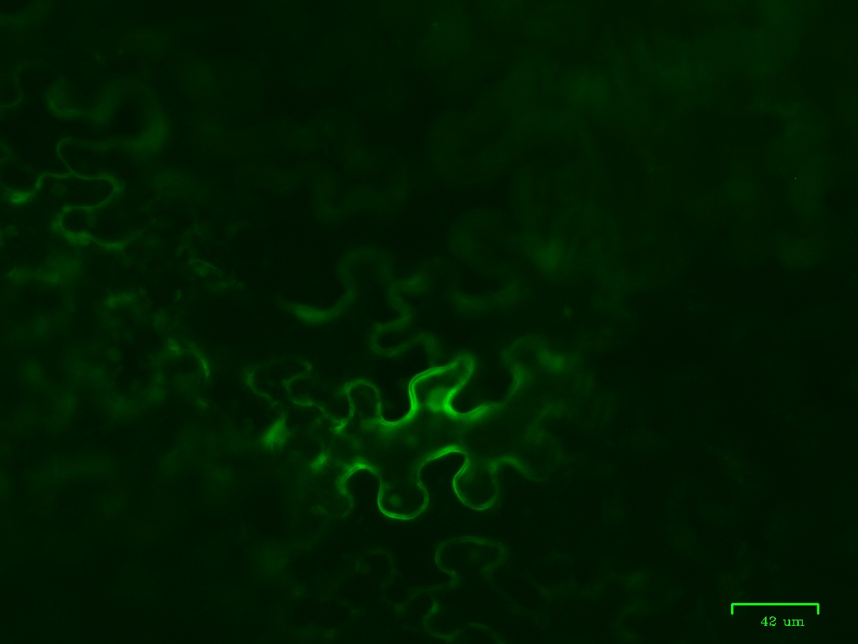
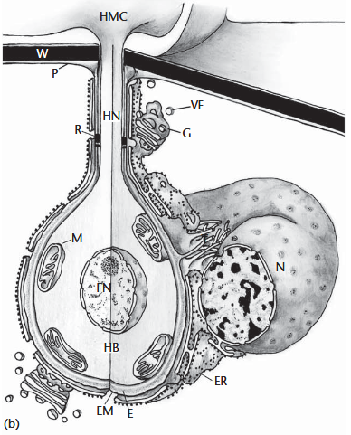
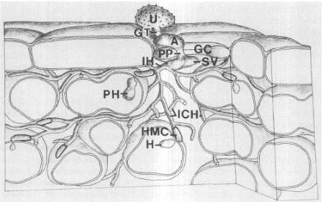
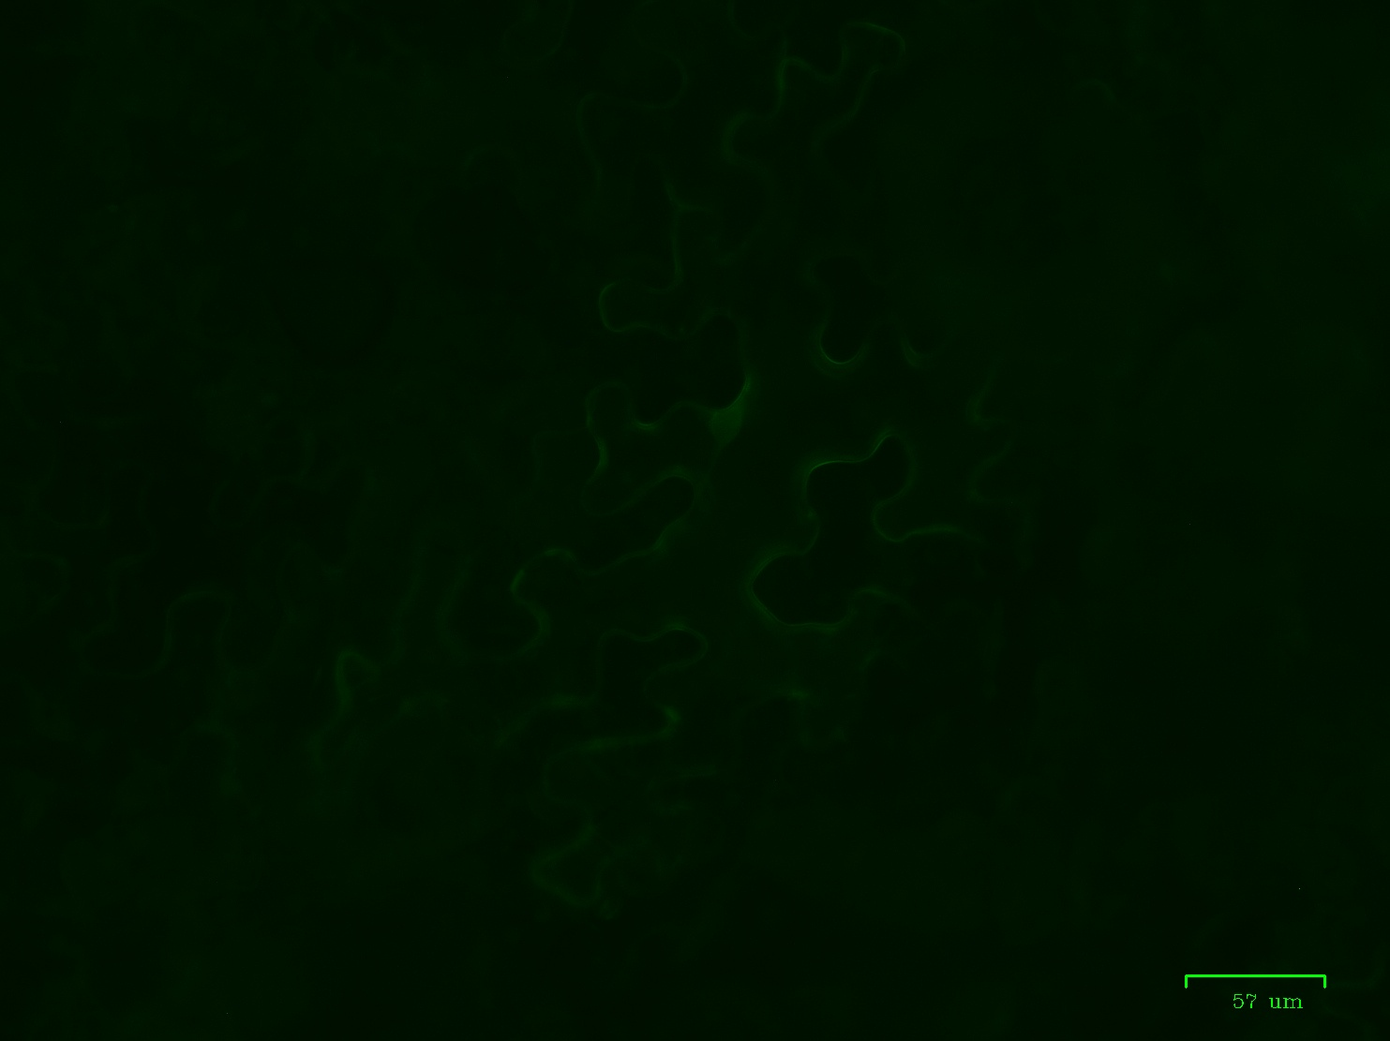
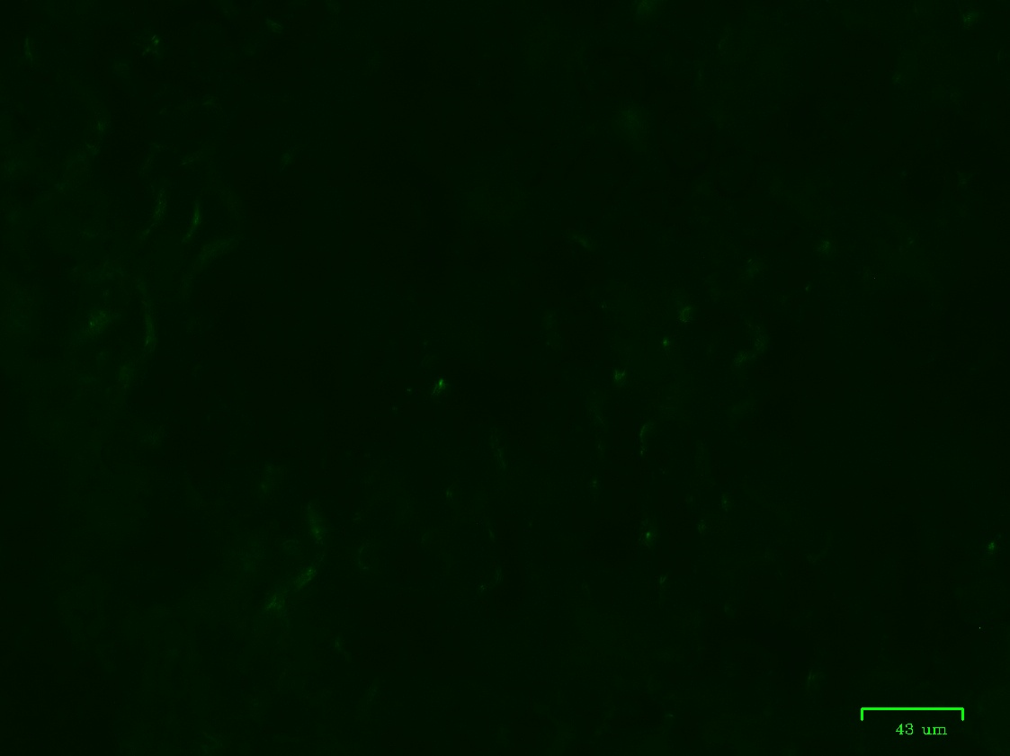


Corn and Rust Disease Interactions
Grant Nielson, Dr. Saet-Byul Kim
Plant Pathology, University of Nebraska-Lincoln
Rust Disease
Background
In a previous study, Dr. Kim isolated P. sorghi haustorial effector proteins and expressed using the Potato Virus X vector. This vector has viral effects, thusly a vector without side-effects was needed to further confirm expression.
Hypothesis
We hypothesize that effectors localizing to the nucleus may regulate the transcript levels of plant genes involved in defense responses.
Methods
Molecular Cloning Design forward and reverse primers in Benchling Extract the PVX vector plasmid from Escherichia coli cell Polymerase chain reaction (PCR) on plasmid template with HF Phusion polymerase and primers Gel electrophoresis to check the PCR product Digestion on template and CDS vector with HF BAMHI and HF KPNI Gel electrophoresis to check enzyme digestion Gel extraction and purification Ligation using T4 DNA Ligase Heat shock transformation into DH5α E. coli cells Grow on solid ampicillin Luria broth plates Pick colonies, grow in ampicillin Luria broth. Extract plasmids from E. coli Sequence utilizing Plasmidsaurus services Transformation into Agrobacterium Digest CDS plasmids containing gene and destination vector with HF BsaI Purify product and Ligate Transform Agrobacterium strain GV3101 + pSOUP Infiltration and Microscopy Infiltrate with N. benthamiana with Agrobacterium containing the gene Image with Bio-Rad ZOE cell imager
Common Rust
All Other Diseases
Results
A
B
Figure 1. A. Southern Rust on Corn Leaf. (Morgan Goodnight, Purdue University). B. Southern Rust accounted for approximately 38% of corn yield loss by bushel amount in 2025, Common rust accounted for less than 0.5% of yield loss. (Sikora et al., 2026)
Southern Rust, caused by the fungus Puccinia polysora, infects corn and causes significant yield loss.
P. polysora is difficult to study in a laboratory setting.
Common Rust, caused by the fungus Puccinia sorghi, exhibits a similar infection in corn.
Research on this species can provide insight into P. polysora. Both species are obligate biotrophs and must manipulate the host to prevent programmed cell death.
Figure 4. Image of plant epidermis with expressing protein 4A7 tagged with fluorescent markers. Imaged with Bio-Rad ZOE
Figure 5. Image of plant epidermis with expressing protein 4A8 tagged with fluorescent markers. Imaged with Bio-Rad ZOE
Figure 3. Invasion of Puccinia. Urediospore (U),appressorium (A) germ tube (GT) guard cells (GC) penetration peg (PP) substomatal vesicle (SV) infection hypha (IH) primary haustorium (PH) intercellular hyphae (ICH), additional haustoria (H). Haustorium mother cells (HMC) are indicated in bold outline (Chong, 1984).
Acknowledgements
Special thanks to: Dr. Saet-Byul Kim, Dr. Ze Tian Fang, Libia Gomez-Trejo, Lauren Gabriel, Emily Francis, and the UN-L McNair Program Staff
Funded by:
The fungus grows through the plant leaf and penetrates cells
Secretes thousands of proteins from haustoria to manipulate host
Figure 2. Cross section of invaded host cell at the site of penetration to show three-dimensional representation of a mature haustoria and association with host cell organelles. E, EH, extrahaustorial matrix; EM, extrahaustorial membrane; ER, endoplasmic reticulum; FN, fungal nucleus; G, golgi body; HB, haustorial body; HMC, haustorial mother cell; HN, haustorial neck; M, mitochondria; N, host nucleus; P, plasmalemma; R, ring neck; T, tubule complex; V, vesicle; W, host cell wall. Drawn by James Chong. (Harder and Chong, 1984)
Figure 6. Image of plant epidermis with expressing protein 4C2 tagged with fluorescent markers. Imaged with Bio-Rad ZOE
Figure 6. Image of plant epidermis with expressing protein 4C4 tagged with fluorescent markers. Imaged with Bio-Rad ZOE
Notes:
Possibly pull out hypothesis, or make it more noticeable
Delete highlighted Greengate
Acknowledgements can be small as 20 if needed.
References can become QR code

